Slide 1
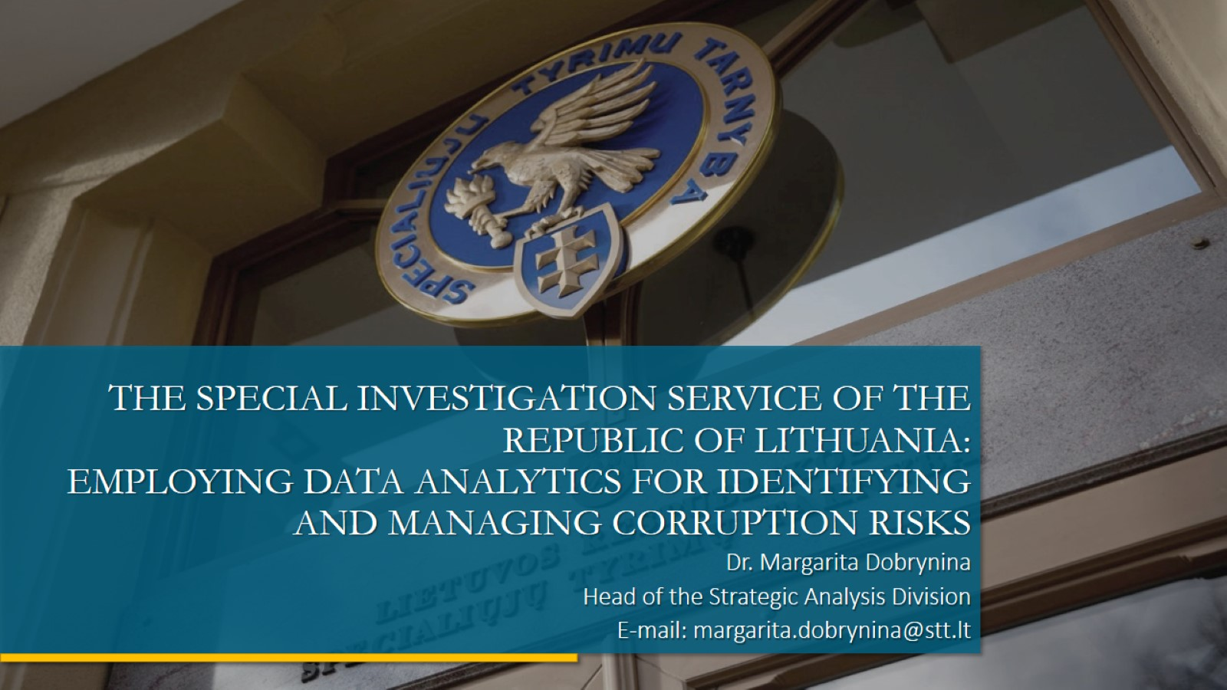
THE SPECIAL INVESTIGATION SERVICE OF THE REPUBLIC OF LITHUANIA:
EMPLOYING DATA ANALYTICS FOR IDENTIFYING AND MANAGING CORRUPTION RISKS

Slide 2
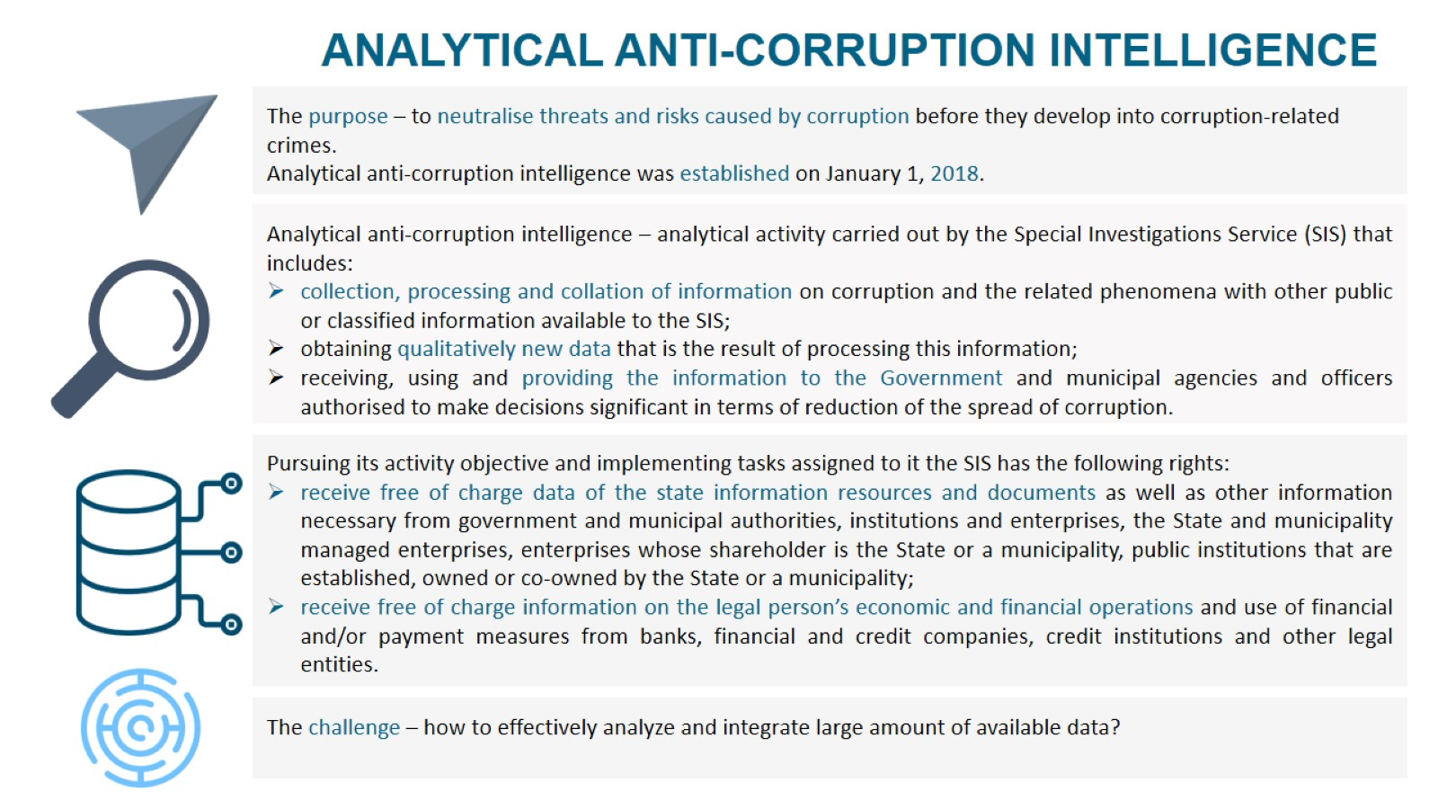

Slide 3
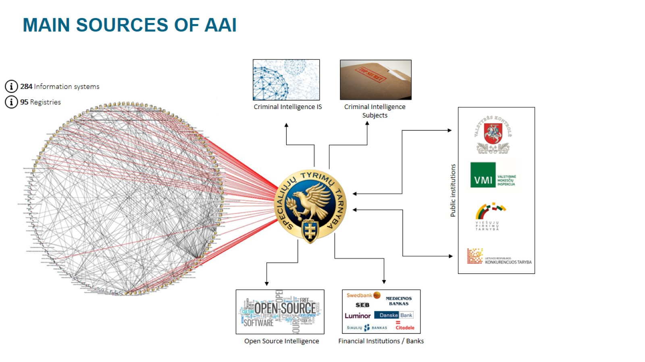

Slide 4
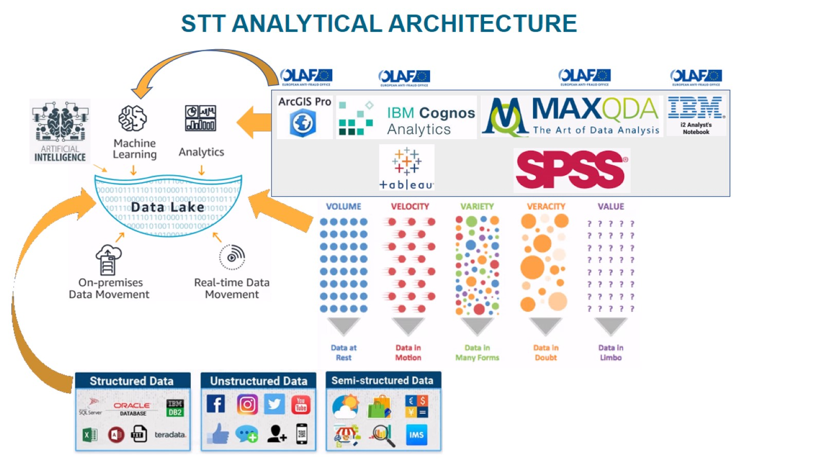

Slide 5
