Slide 1
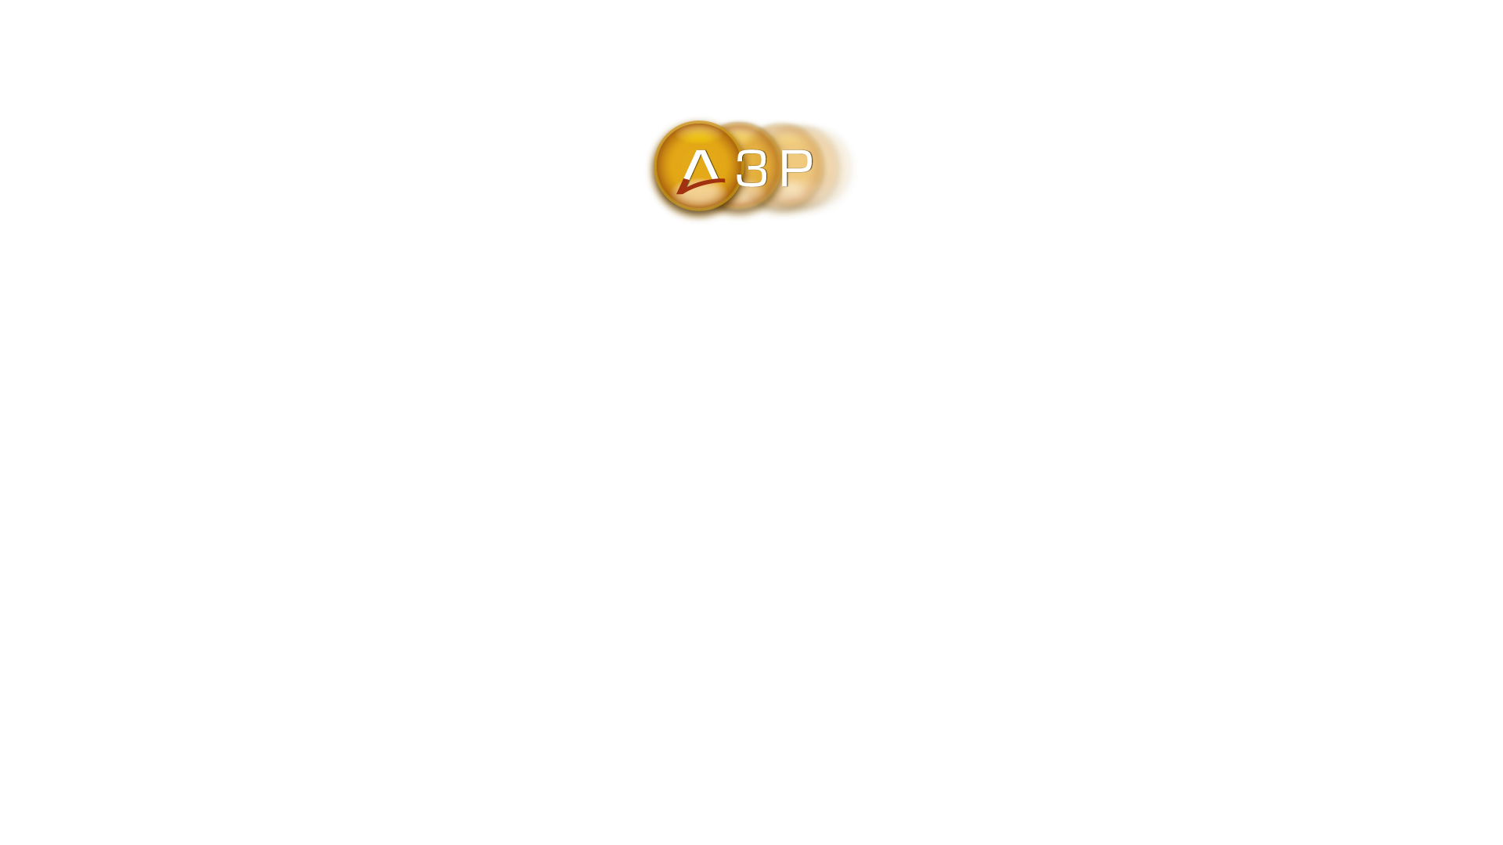
SAO ACTIVITIES AND RESULTS
IN CORRUPTION PREVENTION
October 2023

Slide 2
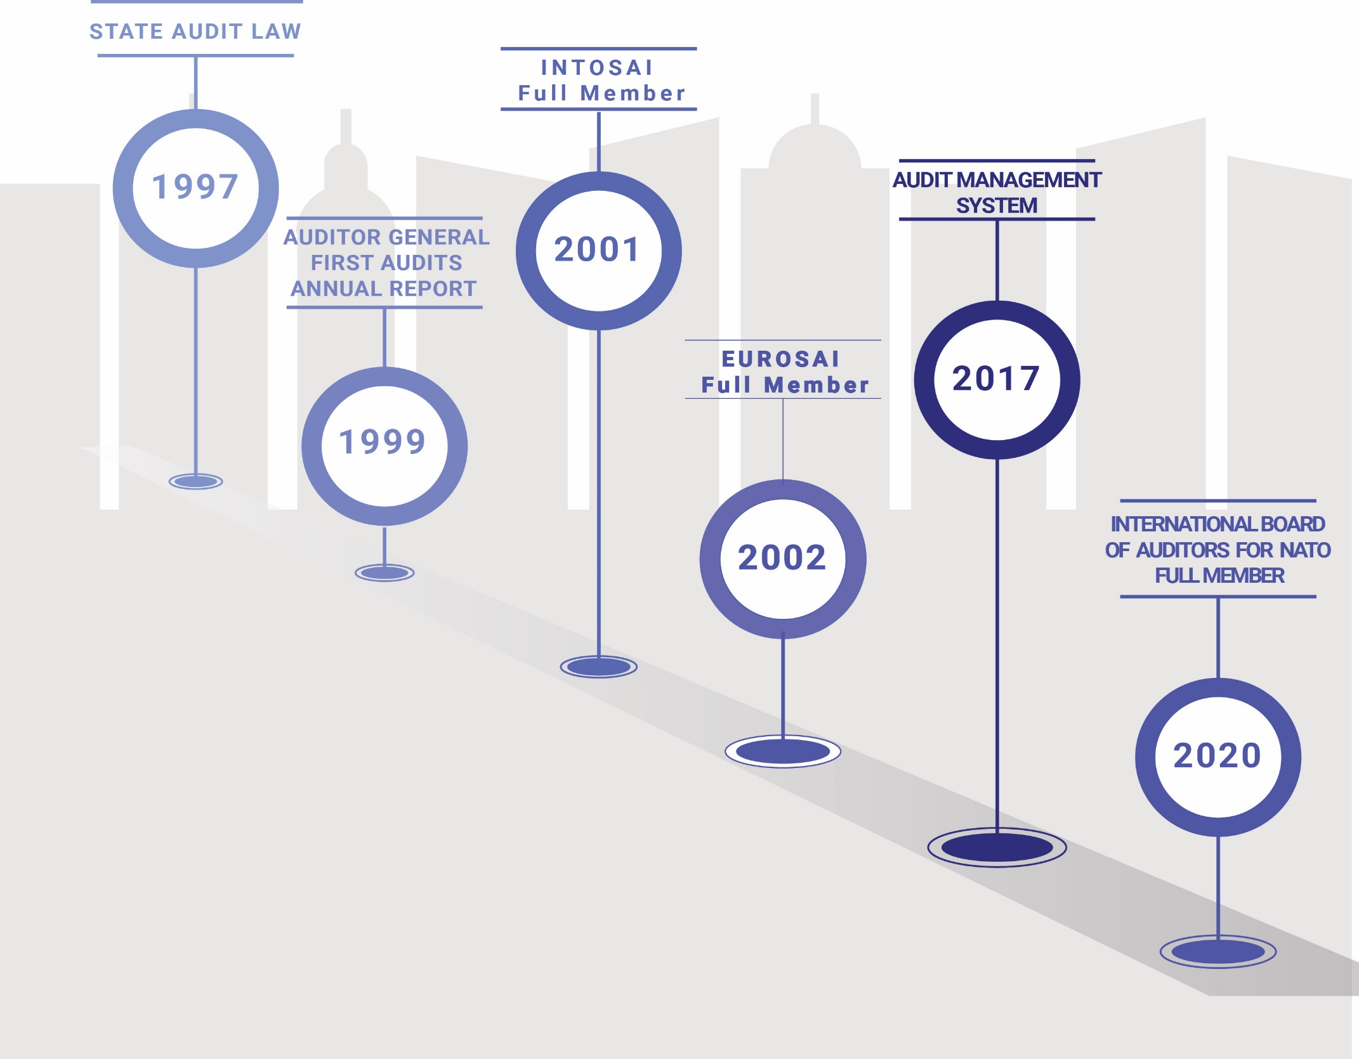
STATE AUDIT
OFFICE

Slide 3
STRATEGIC
DOCUMENTS AND
CORRUPTION PREVENTION
DOCUMENTS
Development Strategy 2023-2027;
Public Finance Management Reform Programme “Smart Finances” 2022-2025
IT Strategy 2023 – 2027
Human Resources Management Strategy 2020 - 2023;
SAO Communication Strategy 2020 - 2023;
SAO Risk Management Strategy 2020-2023 and 2024 - 2027;
Strategic Audit Plan 2021-2023 and 2024-2026;
Annual plan for prevention of corruption 2022;
Code of Ethics for SAO employees;

Slide 4
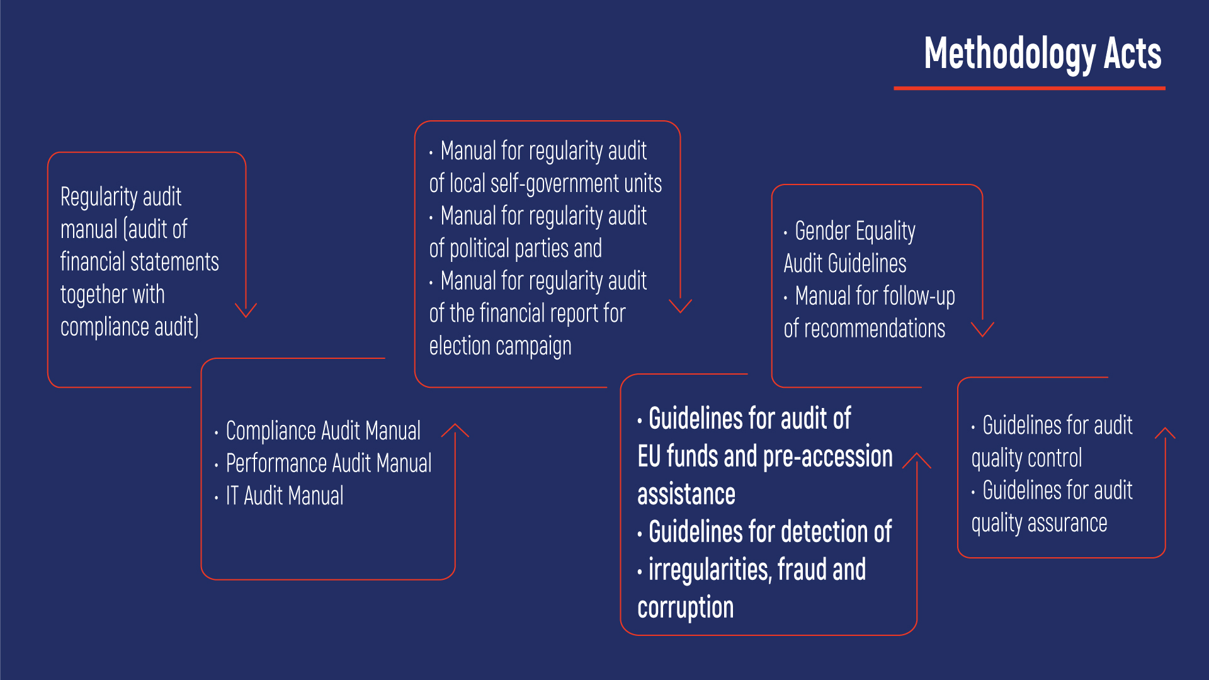

Slide 5
Institutional Capacities
Auditor General
Deputy Auditor General
Secretary General
12 Audit Departments
2 Departments for audit administrative support
AG Advisors
Internal Audit Unit
HR Unit
Corruption Prevention Audit Department

Slide 6
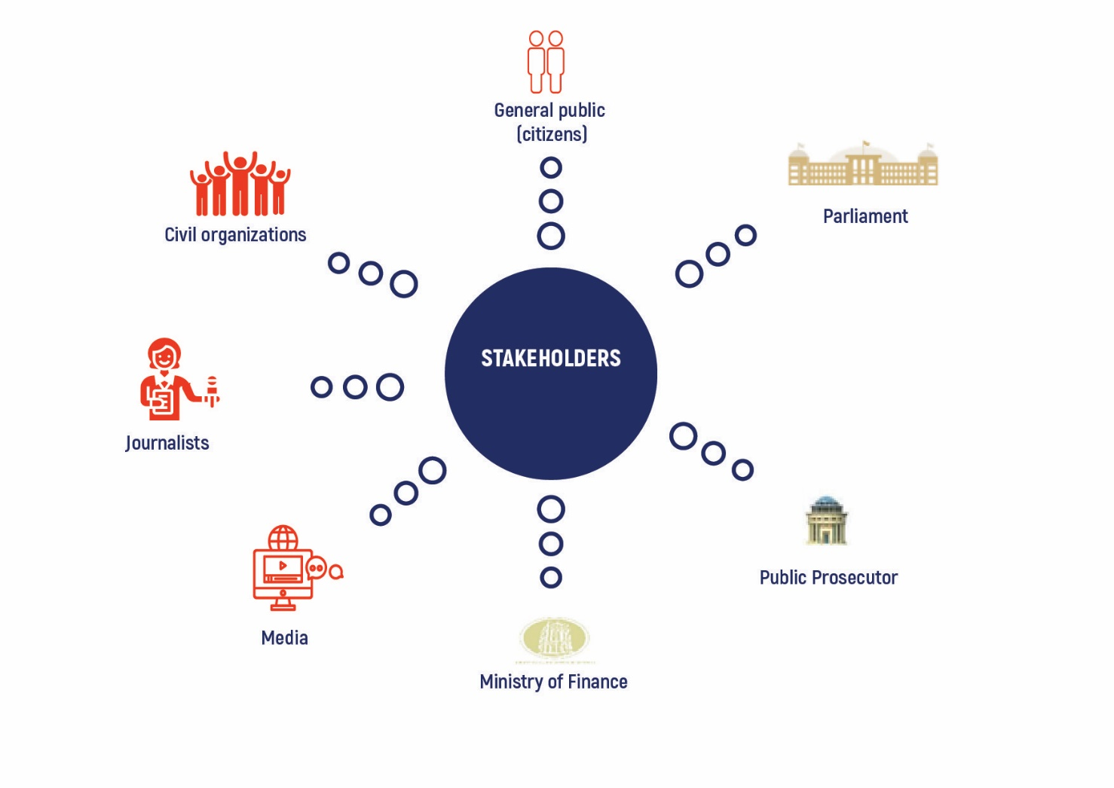

Slide 7
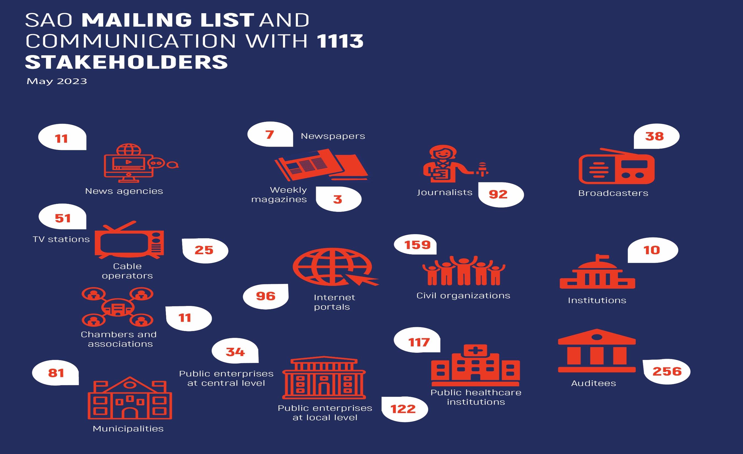

Slide 8
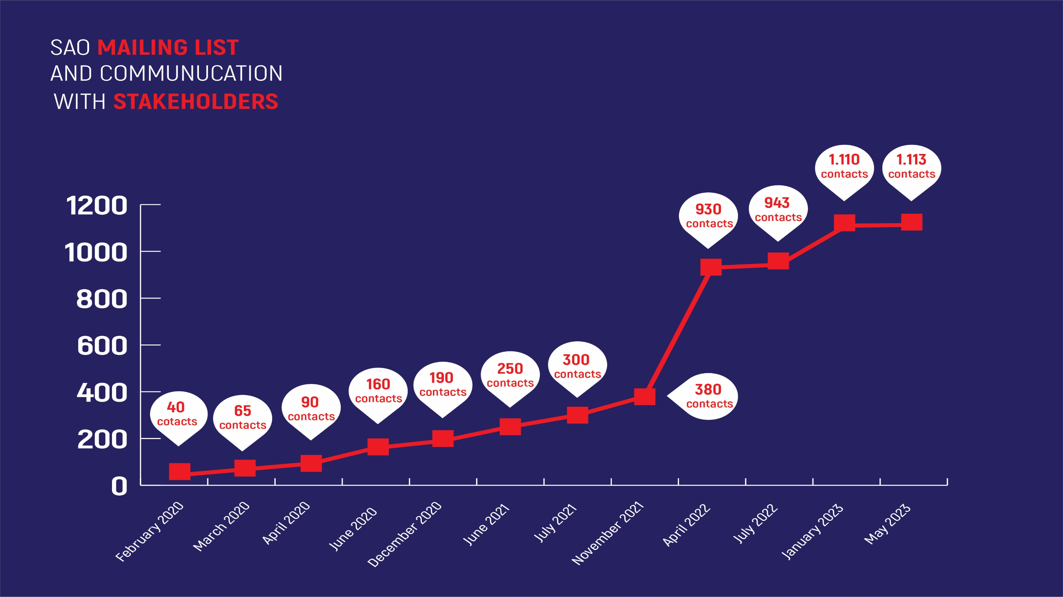

Slide 9
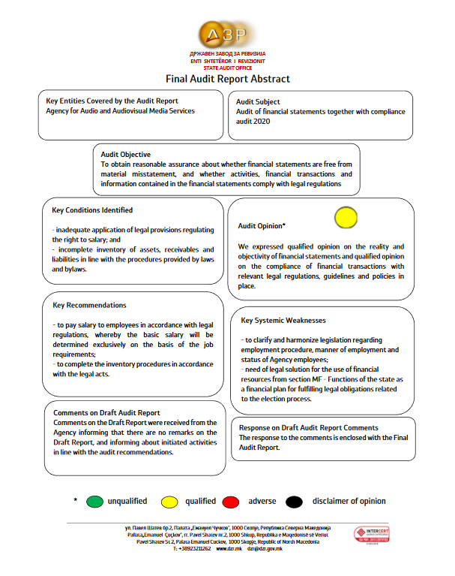
Final Audit Report Abstract

Slide 10
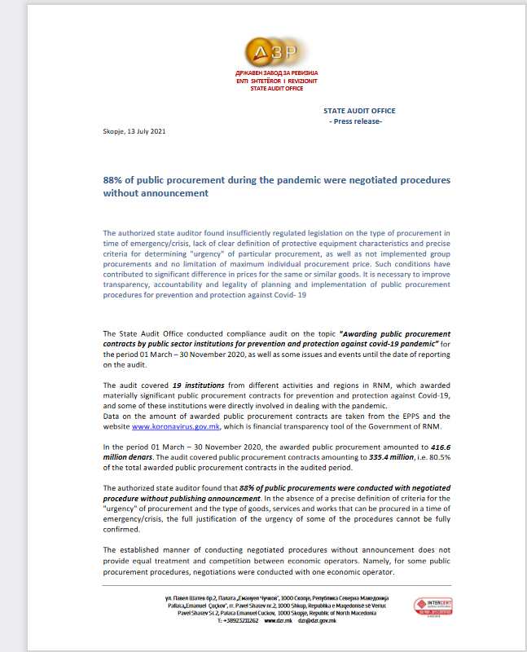
Press release

Slide 11
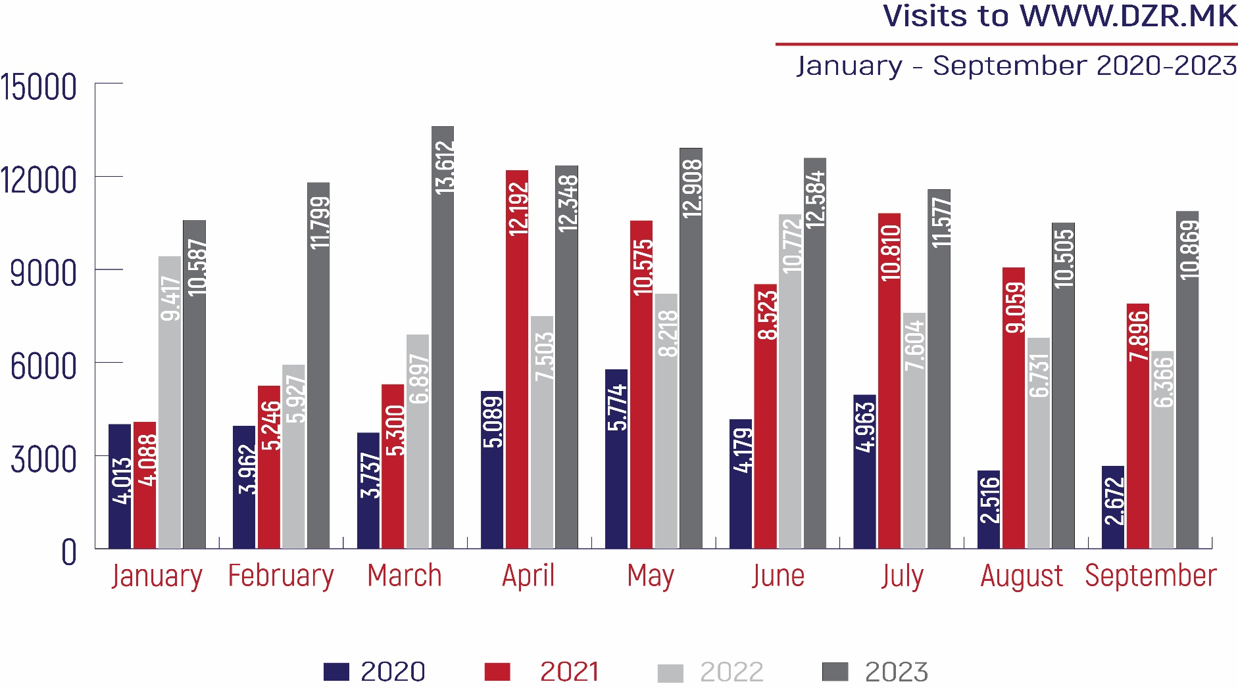

Slide 12
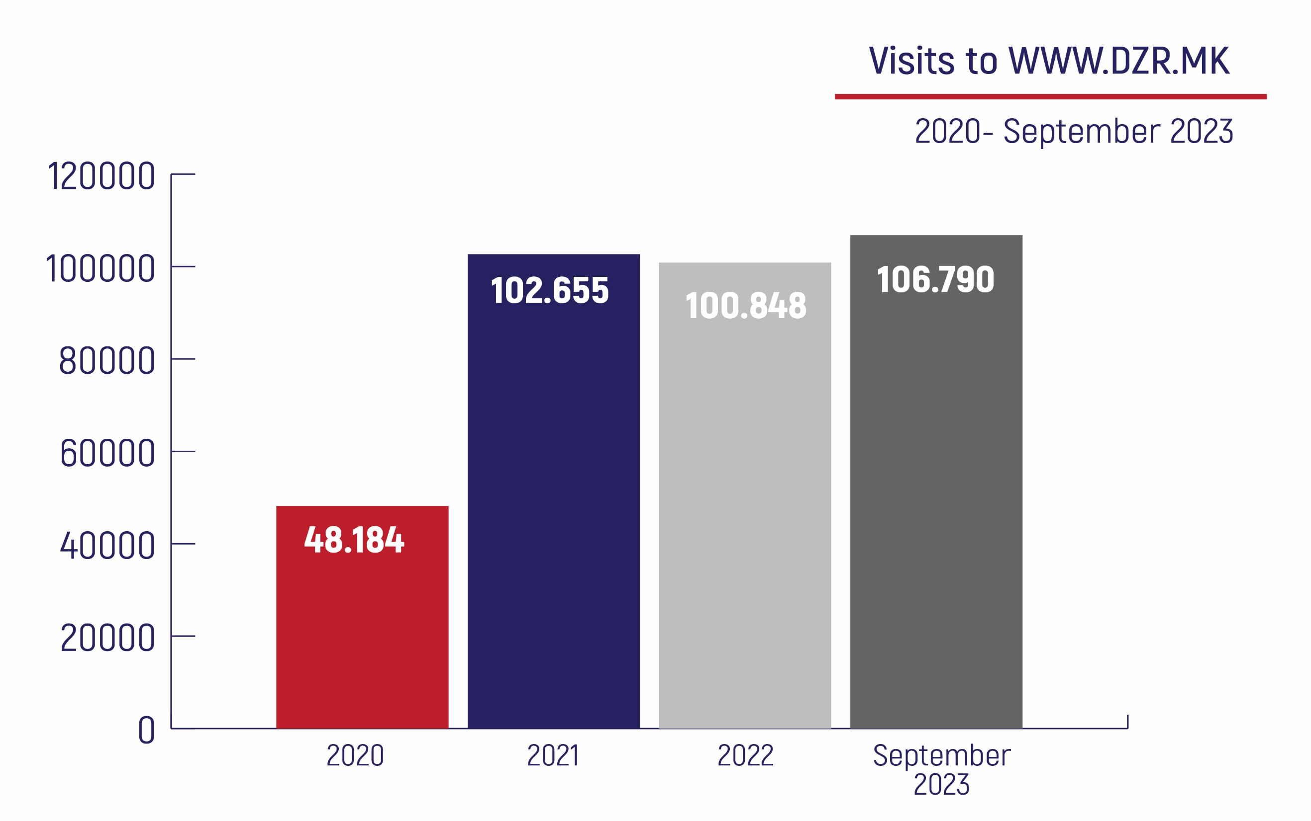

Slide 13
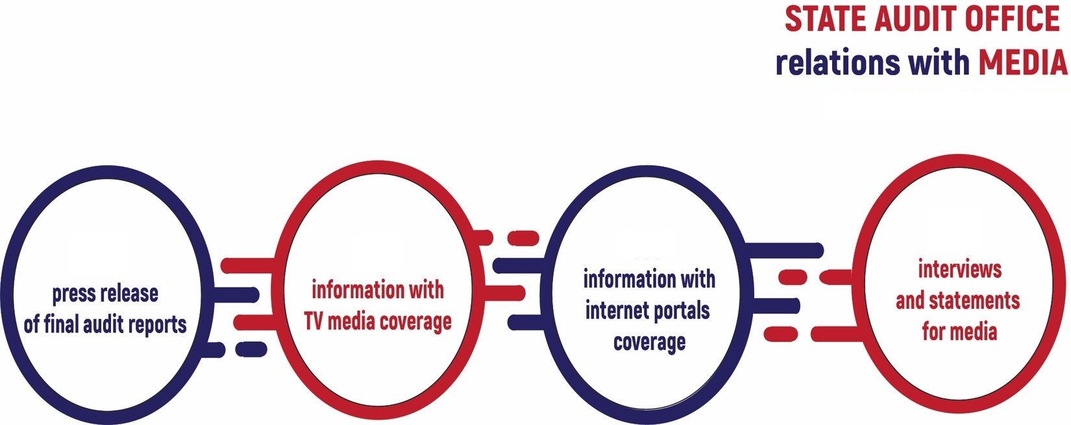
01.01.2020 – 30.09.2023
190
990
28
1.180
1.626
264
1.362
37

Slide 14
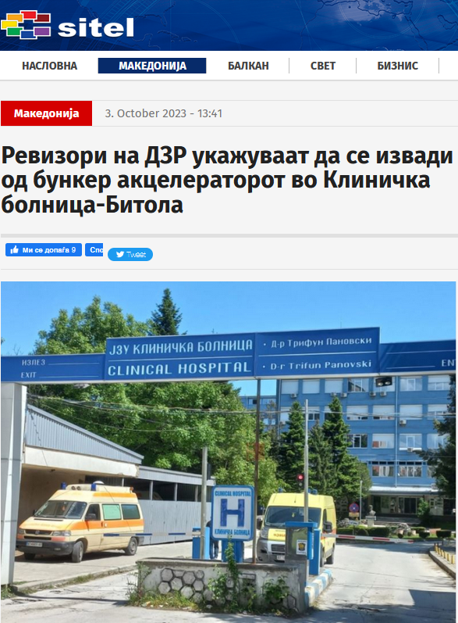
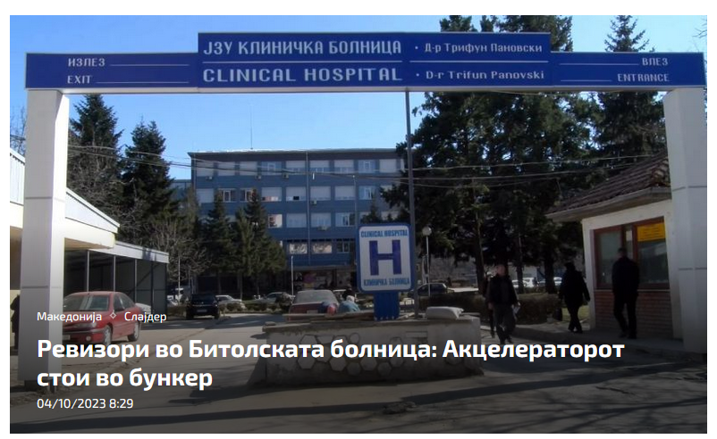
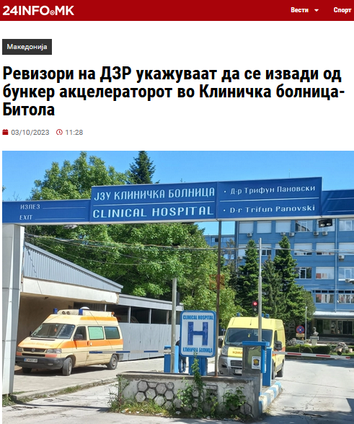
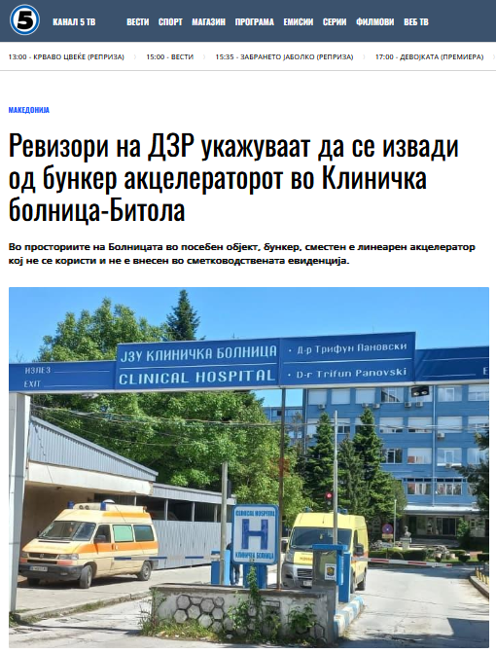
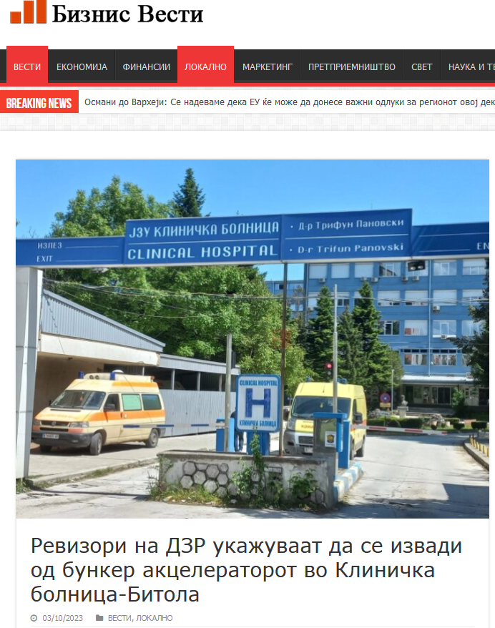
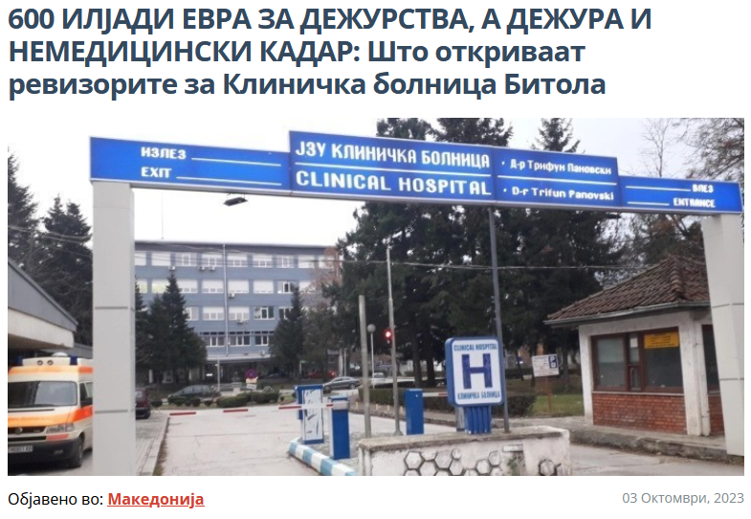
33 publications
in the media and portals for Final Audit Report
PHI Clinic Bitola

Slide 15
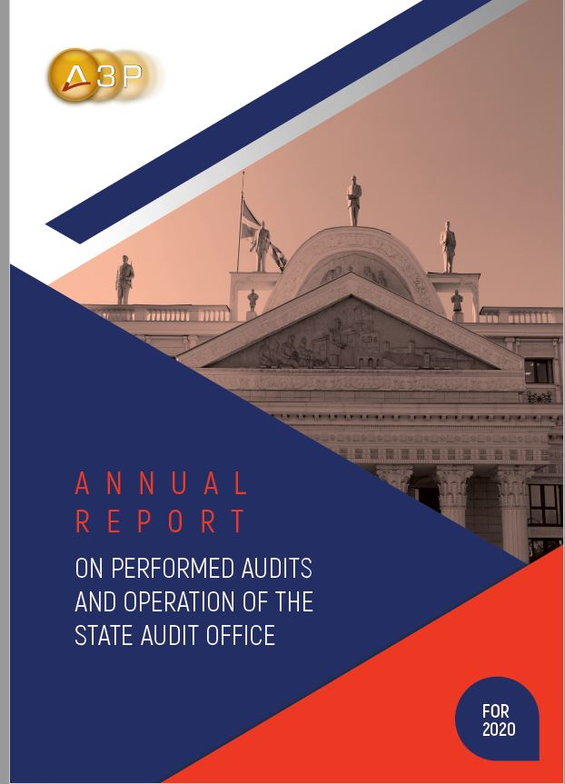
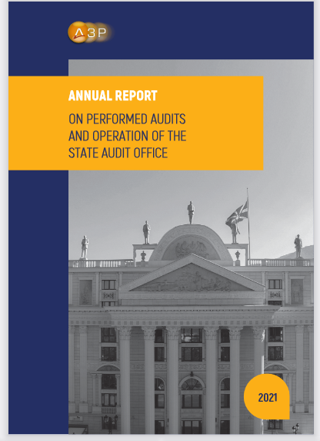
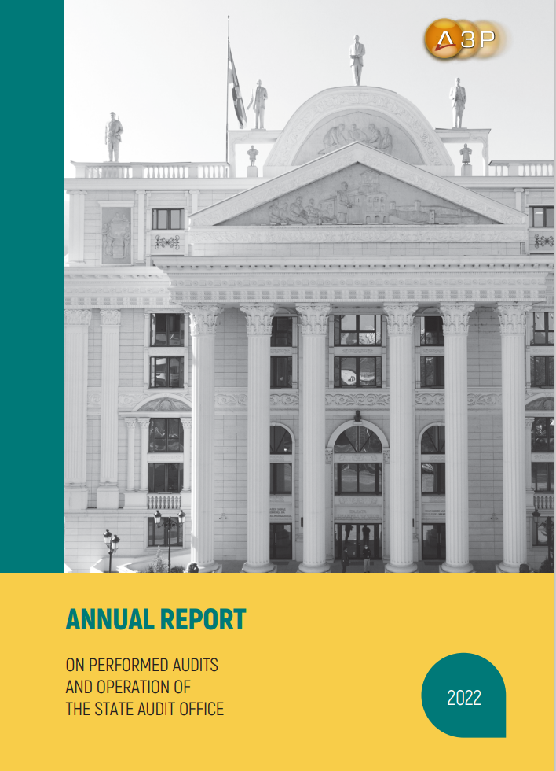
STATE AUDIT OFFICE
Annual report on performed audits and operation of the State Audit Office for 2020, 2021 and 2022

Slide 16
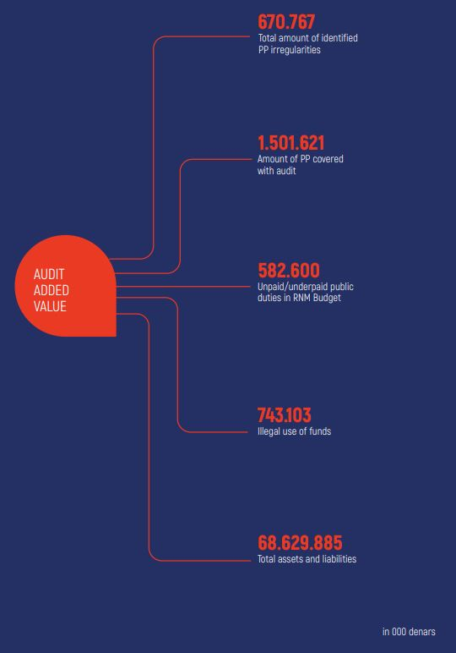
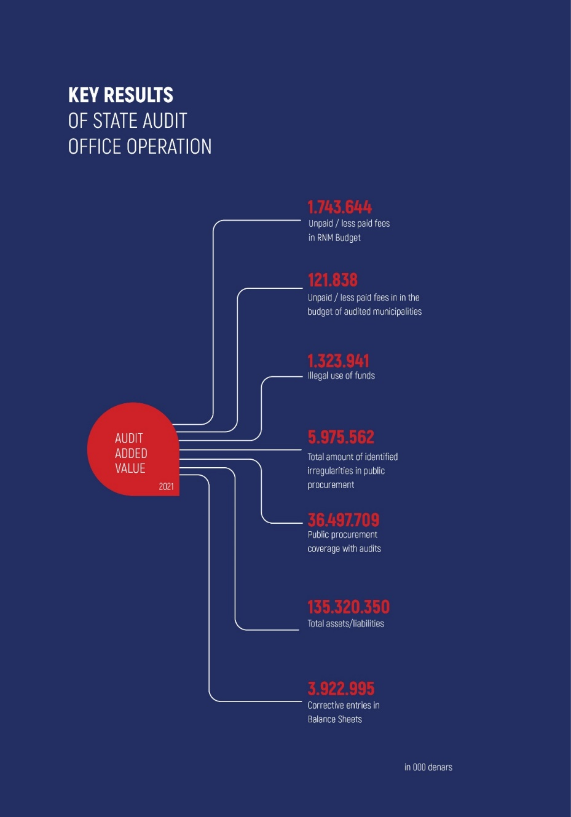
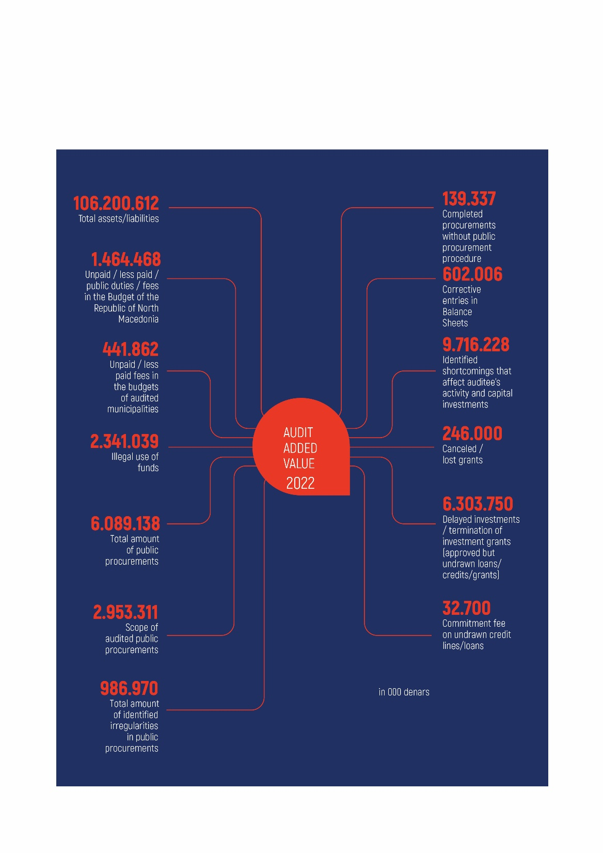
1:5
1:12
1:14
1:5
1:12
2020

Slide 17
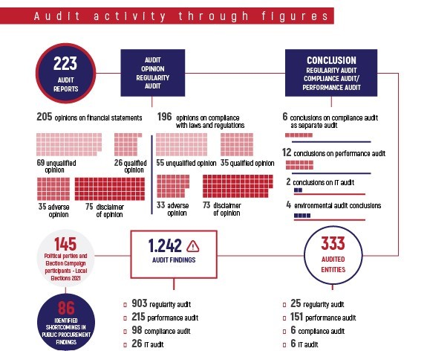
Audit activities through figures
2022

Slide 18
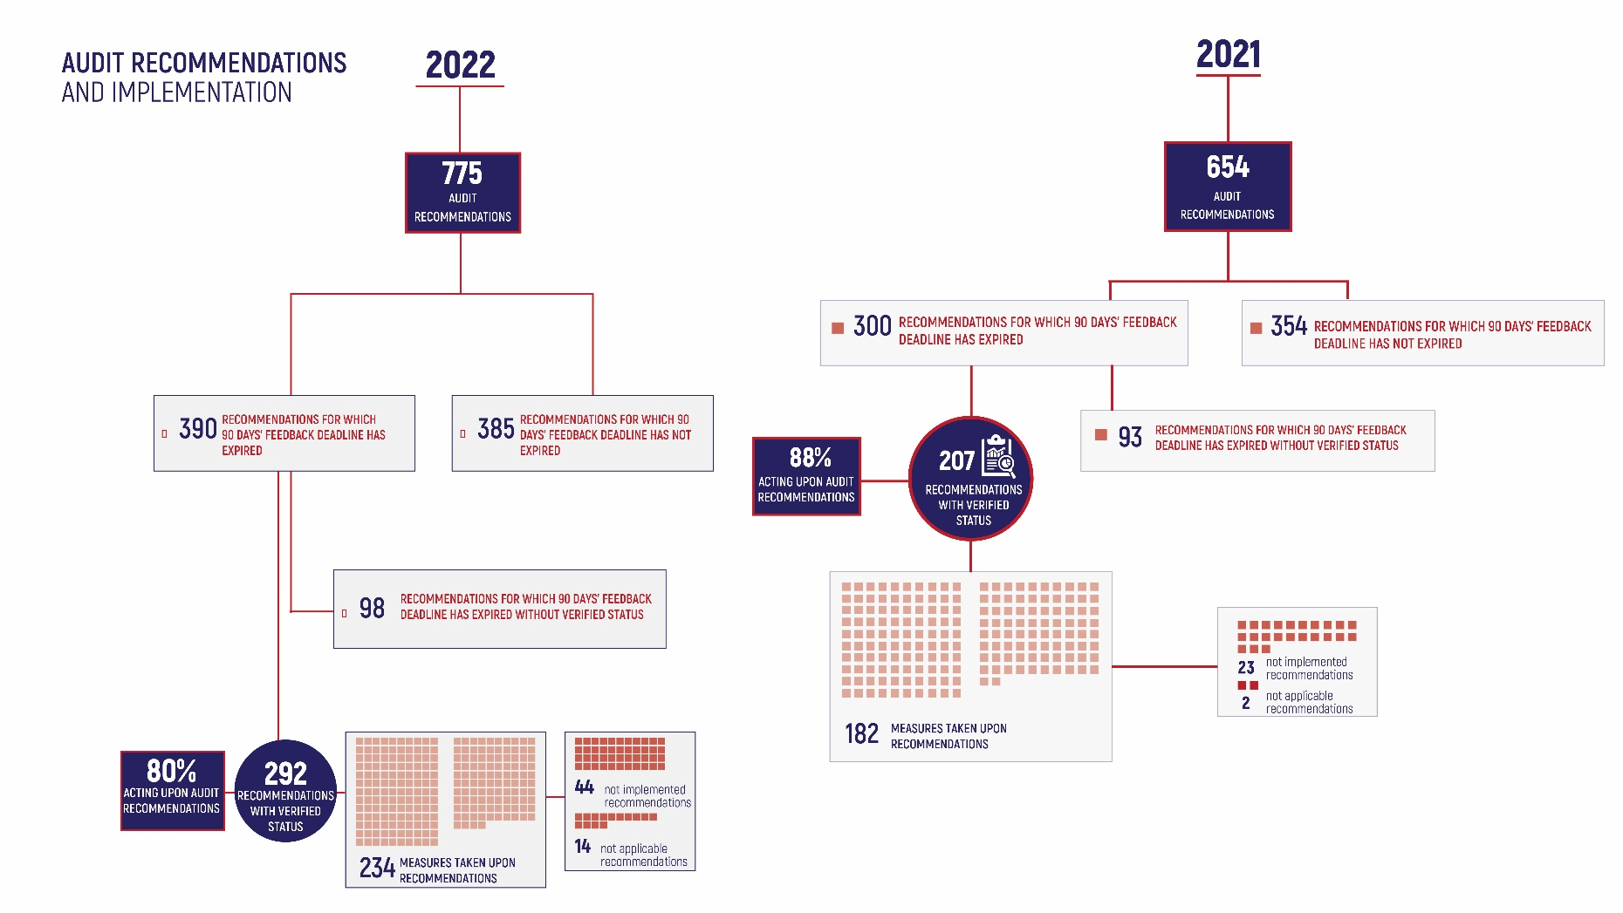

Slide 19
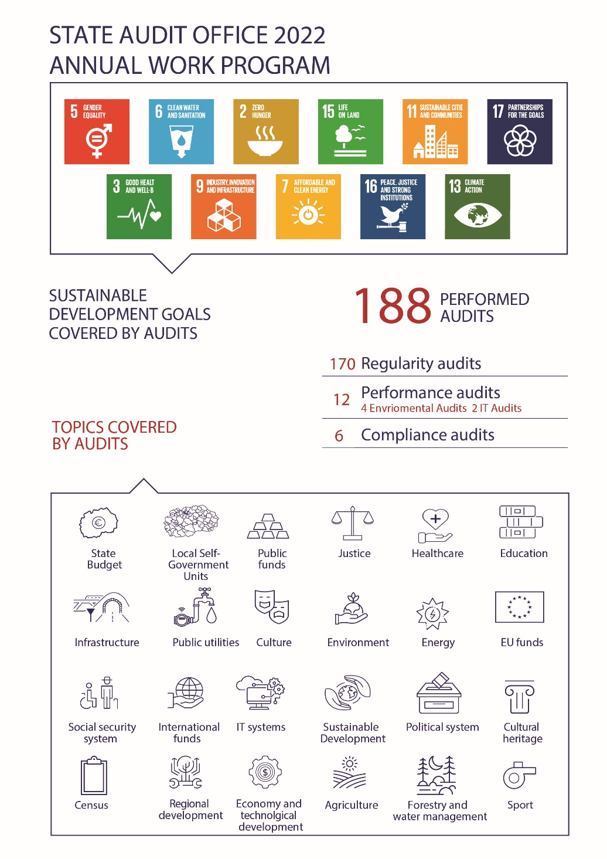

Slide 20
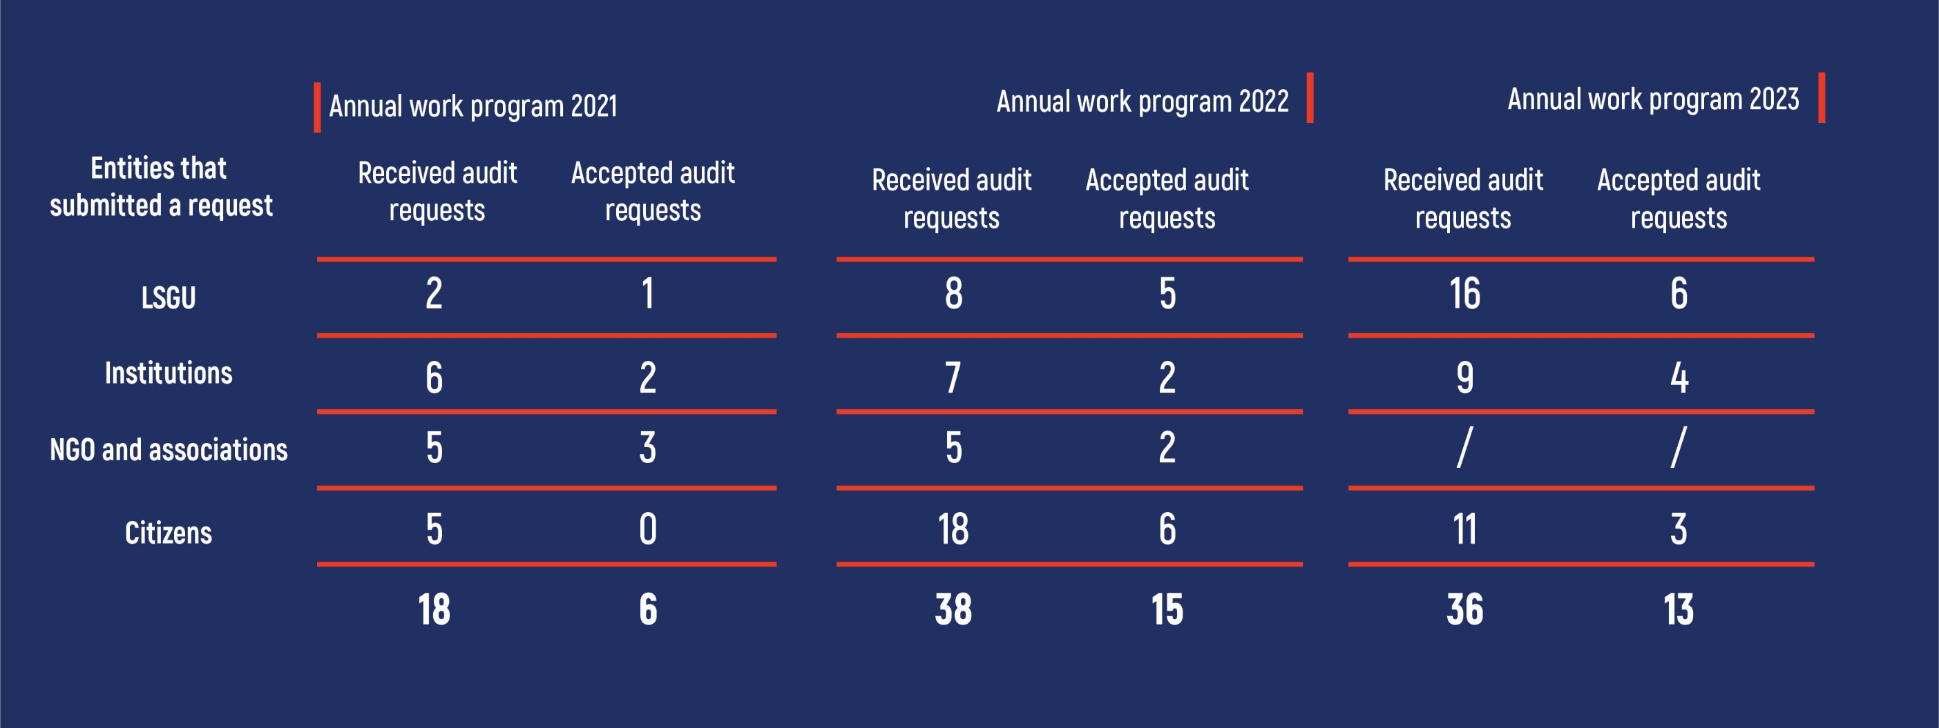
RECEIVED AND ACCEPTED AUDIT REQUESTS
33%
39%
36%

Slide 21
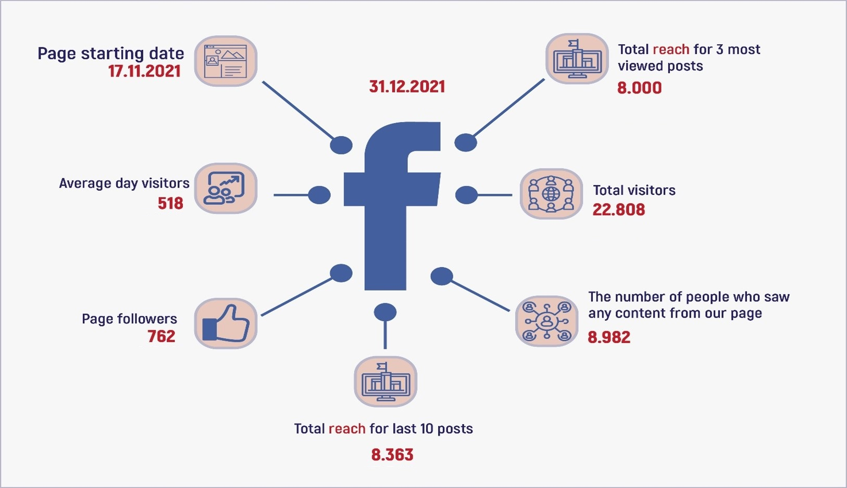
STATE AUDIT OFFICE
TRANSPARENCY
31.12.2021
31.12.2022
31.08.2023
62.869
76.697
}
2.232
1.128.177
705.301
1.468
400.068
6.518
104.908
8.106
114.465
8.637
25.021
17.305

Slide 22
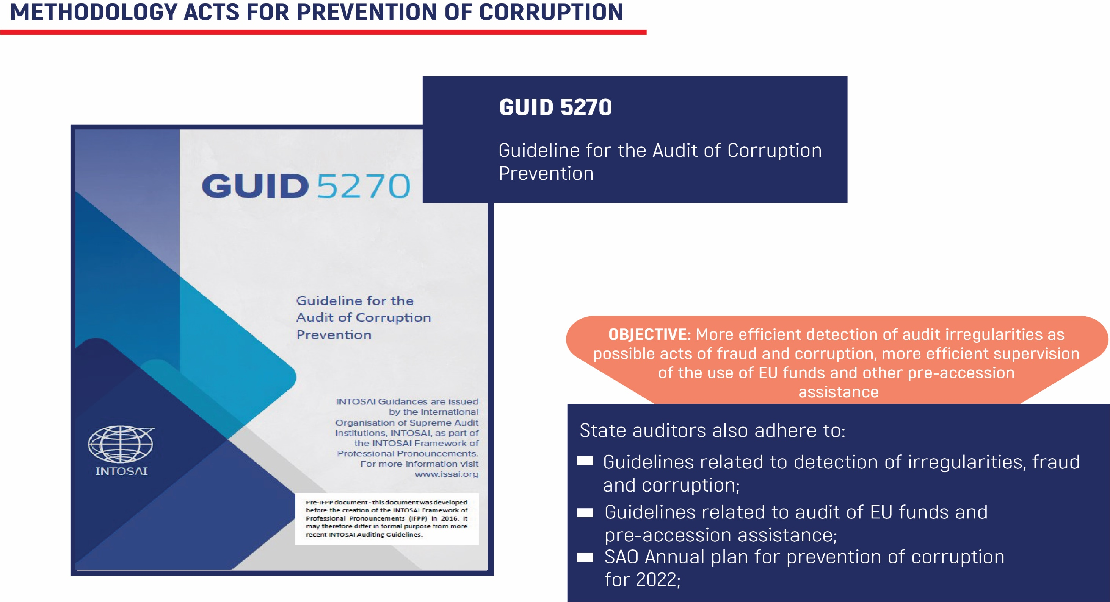

Slide 23
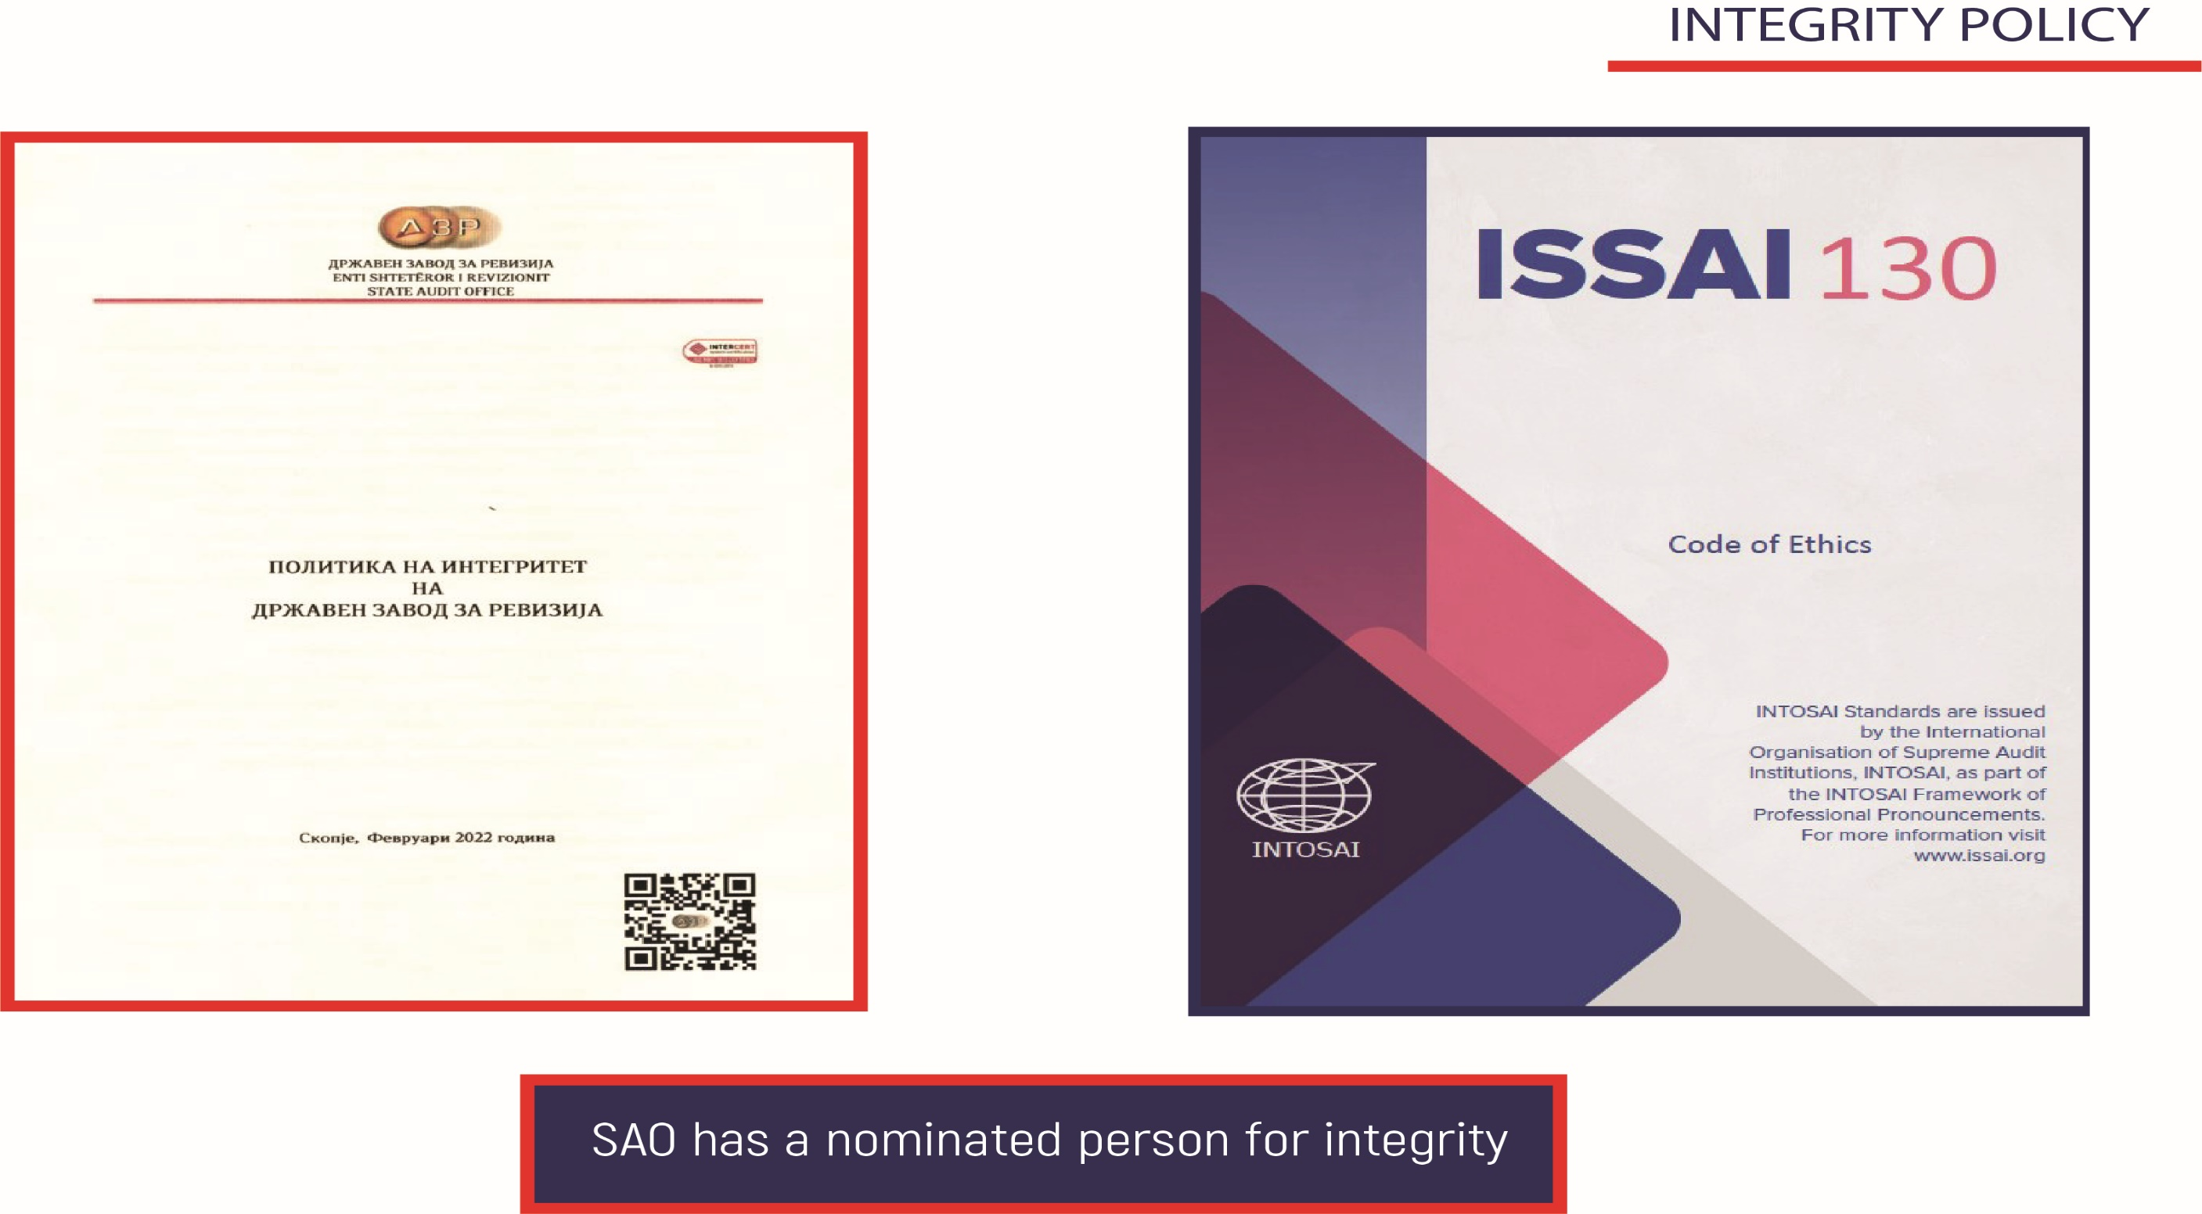

Slide 24
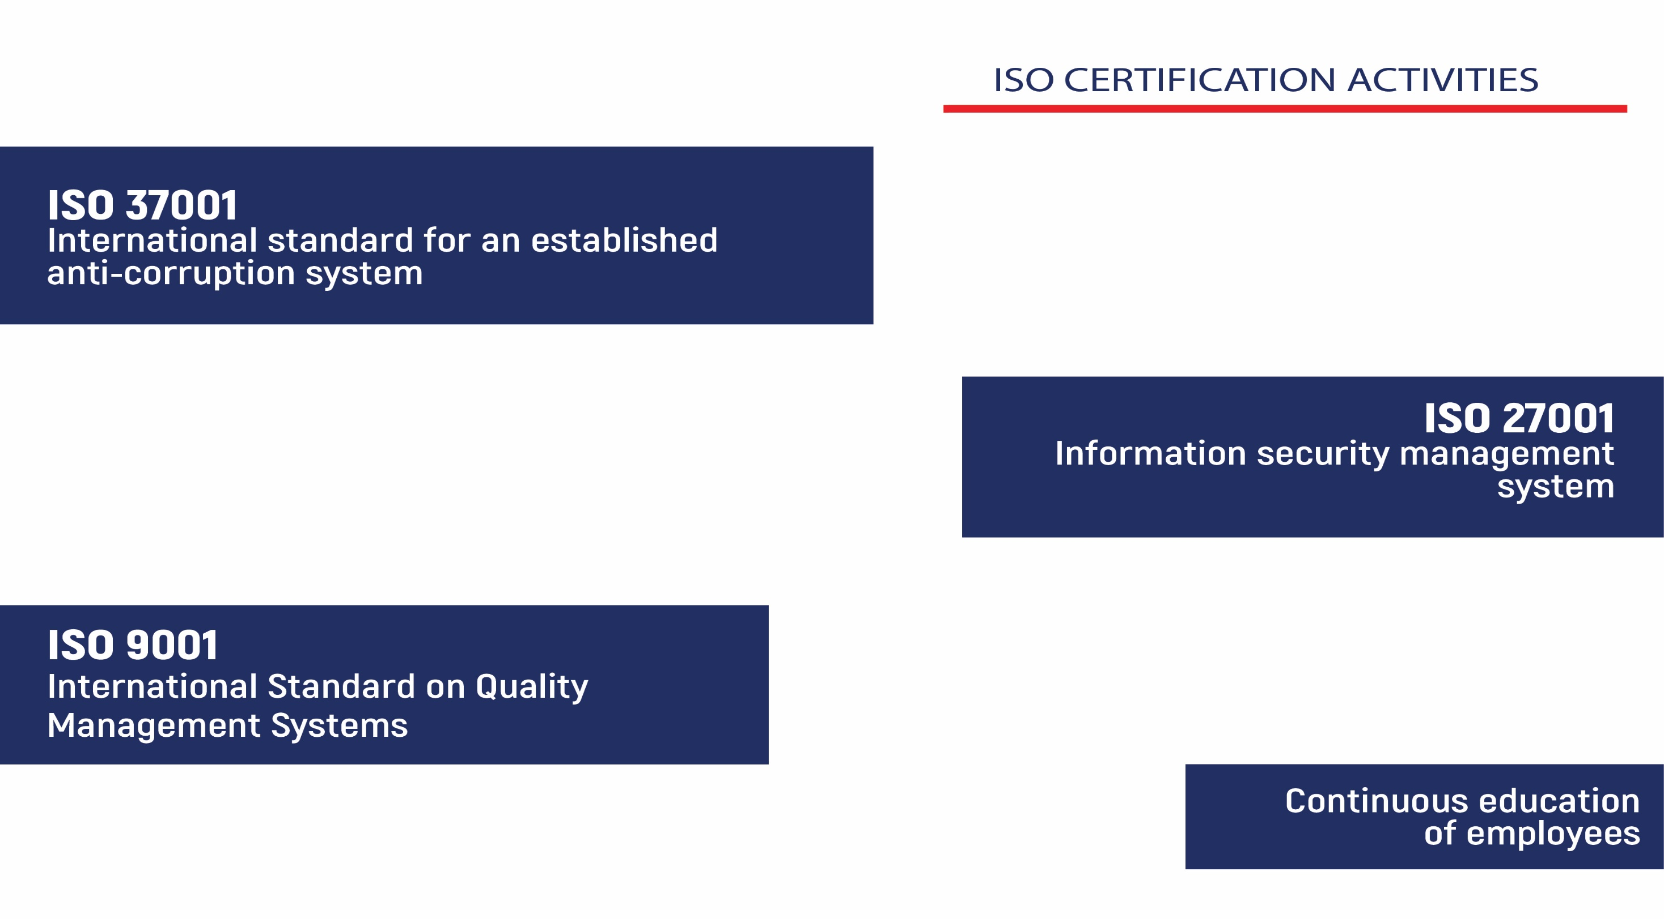

Slide 25
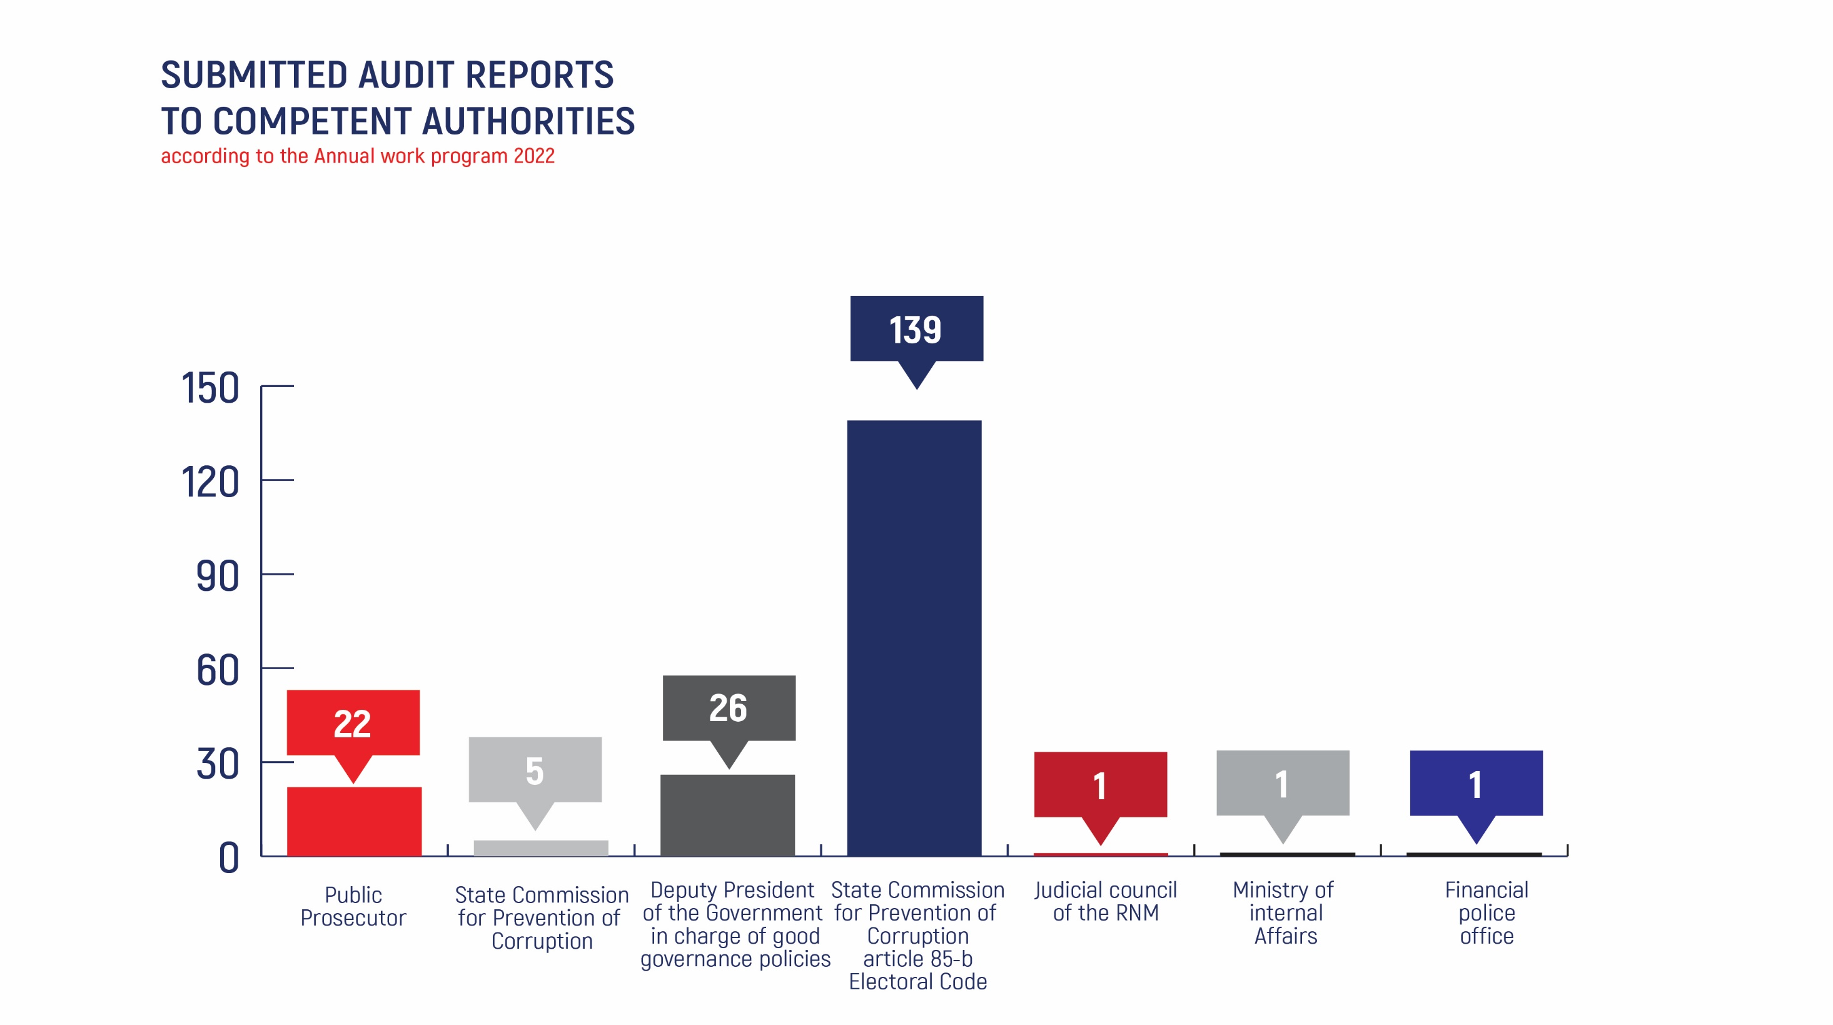

Slide 26
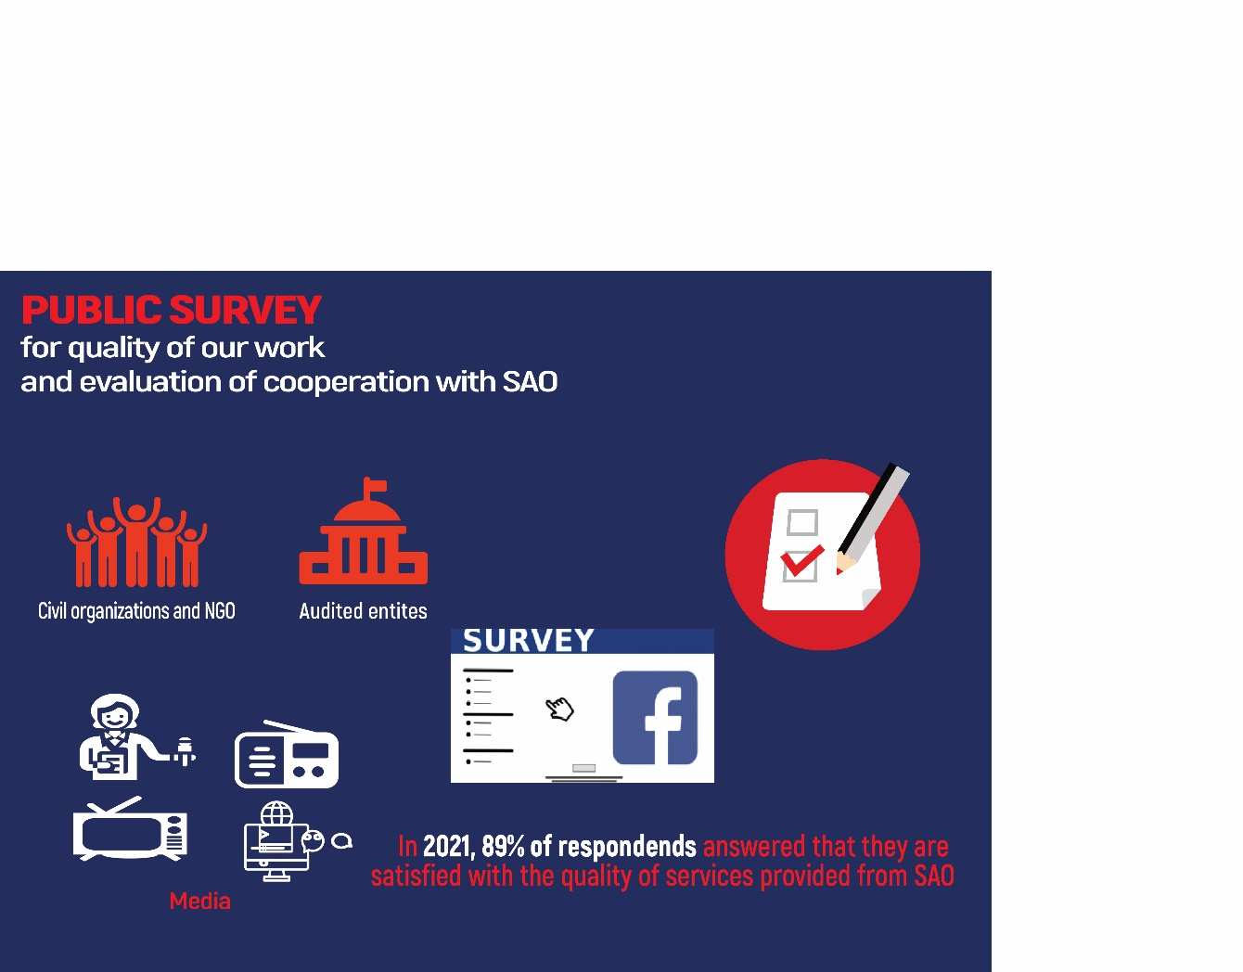
STATE AUDIT OFFICE
2022, 86%

Slide 27
STATE AUDIT OFFICE
Web page:
https://dzr.mk/
Facebook page:
https://www.facebook.com/DrzavenZavodzaRevizija
You tube channel:
https://www.youtube.com/channel/UCNOcjnJlIviFwaxyG-Lyo2w
Linkedin page:
https://www.linkedin.com/company/80909823
THANK YOU FOR YOUR ATTENTION

