Slide 1

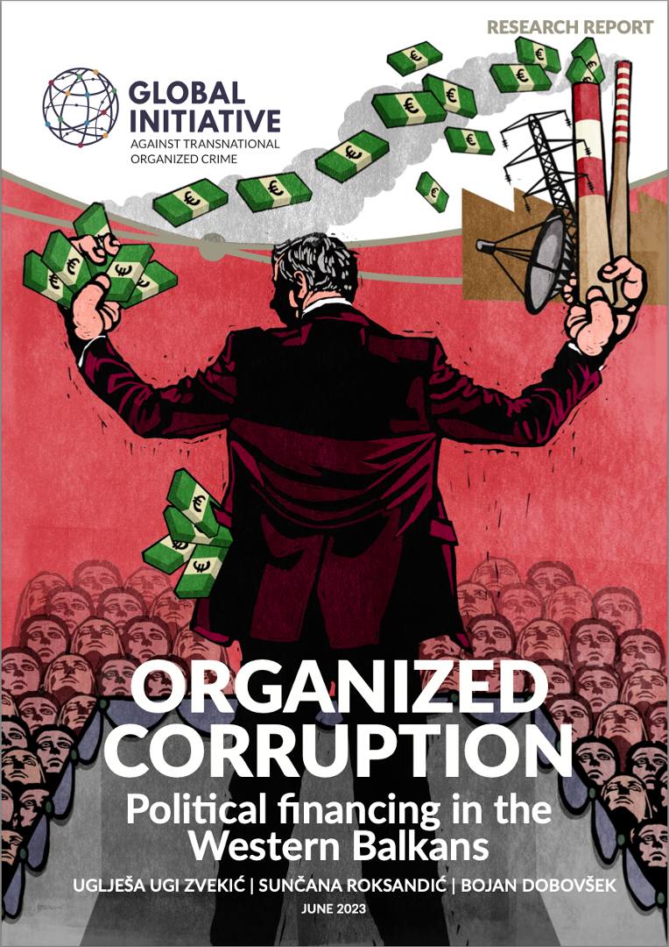

‘Organized Corruption’:
Political Financing in
the Western Balkans
Ioannis Vlassis, Analyst GI-TOC
10 October 2023

Slide 2



Infrastructure of Integrity
Organized Corruption: Political Financing in the Western Balkans
Integrity and Independence of Criminal Justice Institutions

Slide 3

‘ORGANIZED CORRUPTION’
Conventional corruption, bribery and nepotism are culturally well entrenched and often go hand in hand with malfunctioning public administration.
Organized Corruption is the involvement and/or use of an interest organization, criminal or not, of various forms of corruption and related illicit deeds from the position of power and/or with political coverage to gain financial, political or social benefits.
Organized corruption rests on the interwoven criminal, political and economic interest to profit from the power position and political coverage of illicit deeds. Key types of organized corruption in the Western Balkans include:
Political financing
Economic and financial corruption
Illicit personal enrichment

Slide 4

POLITICAL FINANCING
CONCEPT
POLITICAL FINANCING (WB6)
FORMAL
vs
INFORMAL
Transparent, accountable and responsible use and management of public resources
COMPONENTS
1. Financing of Political Parties and elections
2. Political influence and control over public (state-owned) sector enterprises
3. Political use and control over public procurement
FOCUS ON
1. Legislation review
2. Compatibility with International standards
3. Main features
4. Control & Oversight
5. Challenges
Notes:
UZ

Slide 5

The Financing of Political Parties and Elections

Slide 6
CHALLENGES
Legislation exists, yet implementation is lacking.
Lack of transparency – e.g. book-keeping.
Supervision more successful during election campaigns, but issues exist:
  During the pre-election period and,
  Control over media advertising.
Harsher punishments for parties that no longer hold power.

Slide 7
Political Influence and Control over State-Owned (Public) Enterprises

Slide 8

CHALLENGES
Consistent shortcomings in the implementation, even after repeated recommendations – insufficient oversight from relevant control bodies (independence, effectiveness); remedies lacking.
Loyalty to job providers – a political party and its leadership – ‘the election pray’, and ‘ATM’ of the ruling parties.
Lack of transparency – operations, appointments, reporting on the results achieved (e.g. ignoring the obligations to report).
Lack of public accountability – Rare use of judicial action against top management.
Massive debts.

Slide 9
Political use and control over Public Procurement

Slide 10
CHALLENGES
PP particularly exposed to corruption.
The alignment of the laws on PP with EU standards and values – still ongoing process.
Yet there are some clear indications of backtracking.
Need for constant ‘in-depth’ corruption proofing – each stage of the process.
Covid-19 Pandemic: unprecedented opportunity for corrupt actors and highlighted important gaps in the legislation of Western Balkan countries regarding PP in states of emergency.

Slide 11


CONCLUSIONS
The WB6 are still in search of a political culture of integrity.
Progress has been made in regulating and controlling the financing of political parties
  Role of international, and donor community.
Implementation lacking:
  Not sufficiently internalized
  Whole-of-society effort is needed to promote a culture of integrity
  Lack of political will and no ample mandate for control institutions.

Slide 12
CONCLUSIONS
Role of Civil Society is well recognized in the WB6
  But, institutionalization of civil society’s oversight role necessary.
Deep reforms necessary to change the state of affairs
  Not possible if SOEs and the public procurement processes are under the control of the political parties in power and considered to be electoral prey.
A change in the political culture is needed.

Slide 13

Phase 6 Anti-Corruption:
Integrity and Independence of Criminal Justice bodies
POLICE
PROSECUTION
JUDICIARY
SPECIALISED ANTI-CORRUPTION AGENCIES

Slide 14
THANK YOU!
Contact
Ioannis.vlassis@globalinitiative.net
globalinitiative.net

